Slide 1

Employee Turnover Prediction
Present by:
Abeer Alghamdi
Supervisors:
Winston Robson
Mikio Harman

Slide 2

What is The Employee Turnover Rate?
Why it’s important?
Objectives:

Slide 3
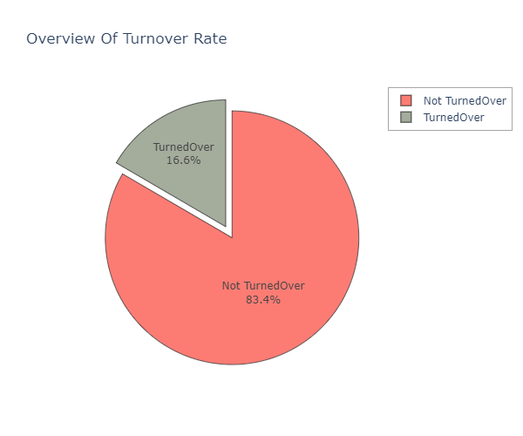
Exploratory Data Analysis (EDA):
Approximately 17% of employees left the company.
The most influential factor was employee satisfaction which had a score of (-35%) .

Slide 4
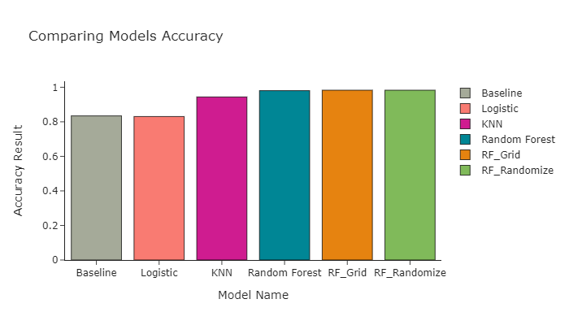
Models and Results:
Baseline Model had a score of 83%.
Logistic Regression had a score of 83%.
KNeighbors Classifier had a score of 94%.
Random Forest Classifier got the highest accuracy scores of 98.03% before tuning, and 98.29% after tuning with GridSearchCV and RandomizedSearchCV.

Slide 5
The End:
Thank for listening

